Slide 1

.

Slide 2
.
Frequency Arrays

Slide 3
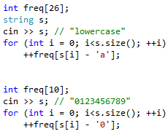
Frequency Arrays

Slide 4
Problem 1
http://a2oj.com/p.jsp?ID=276
Input
3
2 abcabcd
1 ammar
3 abcd
Output
YES
YES
NO

Slide 5
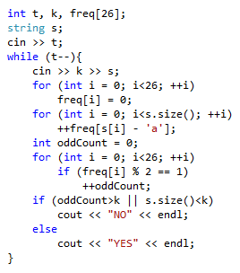
Problem 1

Slide 6
Problem 2
http://codeforces.com/gym/100488 (Problem E - Just Change a Word)
Input
aabccaba
Output
YES

Slide 7
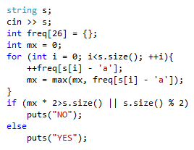
Problem 2

Slide 8
Problem 3
http://codeforces.com/contest/551/problem/B
Input
abbbaaccca
ab
aca
Output
ababacabcc

Slide 9
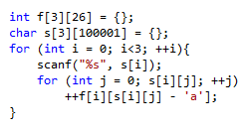
Problem 3

Slide 10
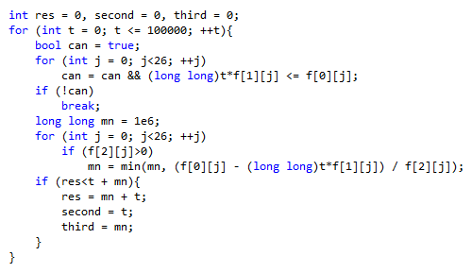
Problem 3

Slide 11
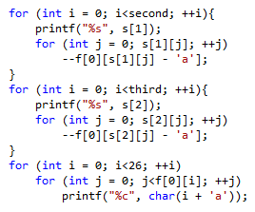
Problem 3

Slide 12
.
Cumulative Sum

Slide 13
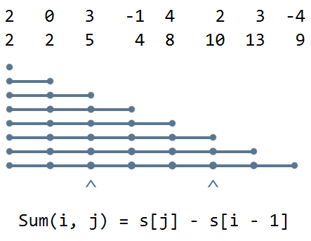
Cumulative Sum

Slide 14
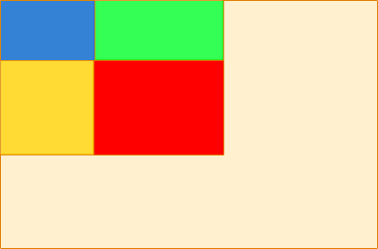
Cumulative Sum - 2D

Slide 15
Problem 4
http://www.spoj.com/problems/CRAN02/
Input
2
4
0 1 -1 0
6
5 2 -2 5 -5 9
Output
6
3

Slide 16
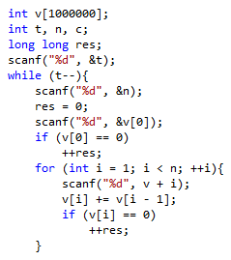
Problem 4

Slide 17
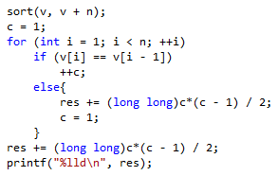
Problem 4

Slide 18
Problem 5
http://codeforces.com/contest/48/problem/B
Input
4 5
0 0 1 0 1
0 1 1 1 0
1 0 1 0 1
1 1 1 1 1
2 3
Output
2

Slide 19
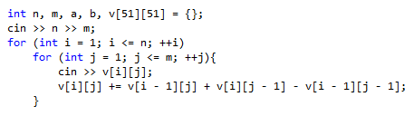
Problem 5

Slide 20
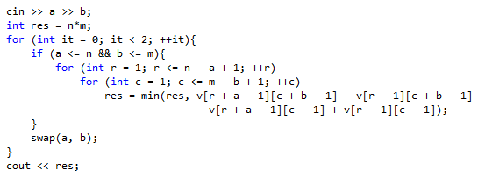
Problem 5

Slide 21
Problem 6
http://codeforces.com/contest/519/problem/D
Input
1 1 -1 1 1 1 1 1 1 1 1 1 1 1 1 7 1 1 1 8 1 1 1 1 1 1
aaa
Output
2

Slide 22
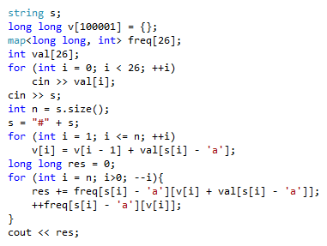
Problem 6

